Slide 1
SMART PROJECT MANAGEMENT SYSTEM
2021-234

Slide 2
Overall Project Description

Slide 3
Overall Project Description
Research Problem
Current student grouping process is not effective.
Managing and checking progress of projects is a exhausting process.
Existing project management systems doesn’t include a peer review facility.
Students having difficulty to find a project.

Slide 4
Main Objective
Develop a Project Management System to improve team work skills among students and Automate current project management system.

Slide 5

IT18009446 Amarasekara T.N.E. IT
Research Section 1
Automate Project Group Generation

Slide 6
Specific and Sub Objectives
Specific Objectives
Develop a grouping algorithm to automate student grouping process
Sub Objectives
Data collection.
Analyze the data and find relationships between data.
Using data analysis find an optimal algorithm or algorithms to achieve the expected results
Test algorithms and output a model that can be used for the grouping process.

Slide 7
Research Methodology
grouping algorithm
grouping algorithm Extended
Final result

Slide 8
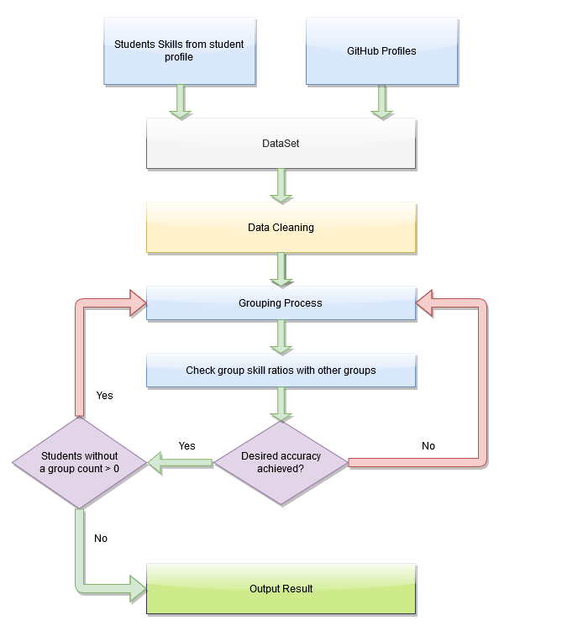
Grouping Algorithm
Data Requirements
Student GPA
Programming Skills
Base Languages
Frameworks
DBM systems
Version Controlling
Previous Projects
Used programming languages
GitHub Repositories
Used programming languages
✔
✔
✔
✔
✔
✔
✔
✔

Slide 9
Grouping Algorithm
Create Initial Groups
Create Group Balancer
Create Group Balance Iterator
Output Results
✔
✔
✔
✔

Slide 10
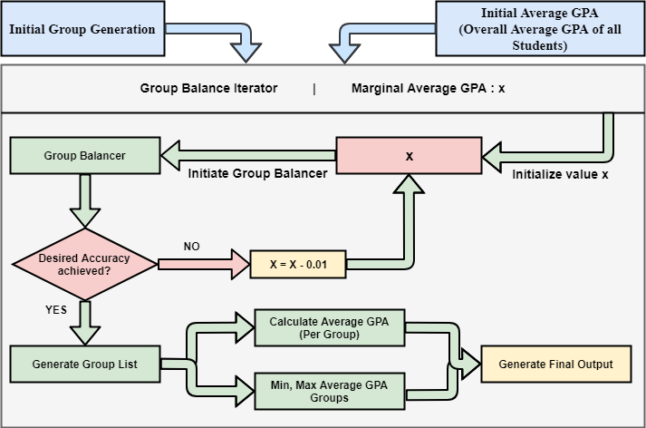
Grouping Algorithm Extended

Slide 11
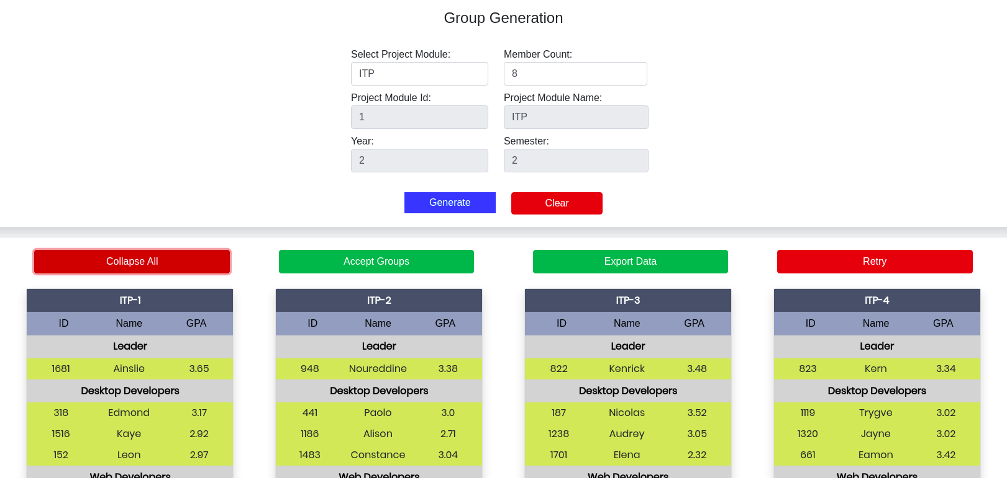
Final Result

Slide 12

IT18140330 Gamage O.M. SE
Research Section 2
Predict future GitHub contribution and Progress Tracking

Slide 13

Objectives
Predict Future Contribution and Progress Tracking using GitHub REST API.
Sub Objectives
Create system component to Track the project progress using GitHub REST API.
Task Management Dashboard to handle Tasks.
Creating Issue Tracking system similar as stack overflow.
Generating Performance report.

Slide 14

Research Methodology
Methodology

Slide 15
Methodology
Predict Future Contribution and Progress Tracking using GitHub REST API.
Create Project Environment and add GitHub data.
Track the Project Progress using GitHub REST API .
Predict Future Contribution for each member using weekly commits progress.
Assign Tasks and Manage Tasks.
Share Issues/ Errors / Questions in SMARTIssues.
Generating Performance report.

Slide 16
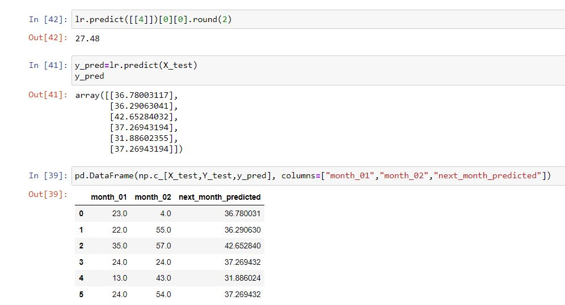
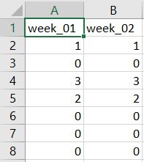
Methodology – Predict Future Contribution
Dataset – Collect each member’s weekly commit contribution.
Predict using Supervised Learning Algorithm.

Slide 17
Evidences
Evidences for the completion

Slide 18
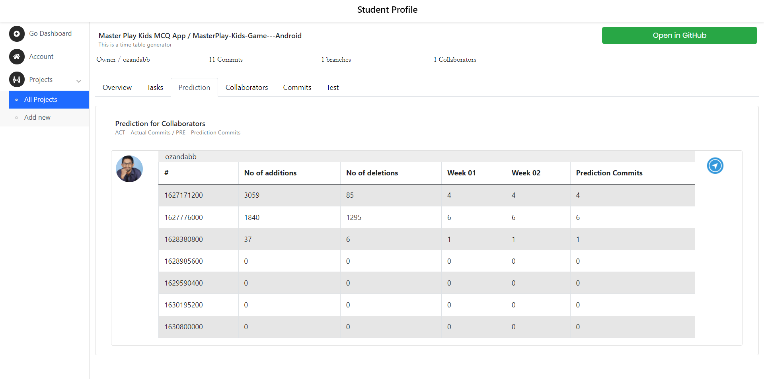
Prediction per Each Member

Slide 19
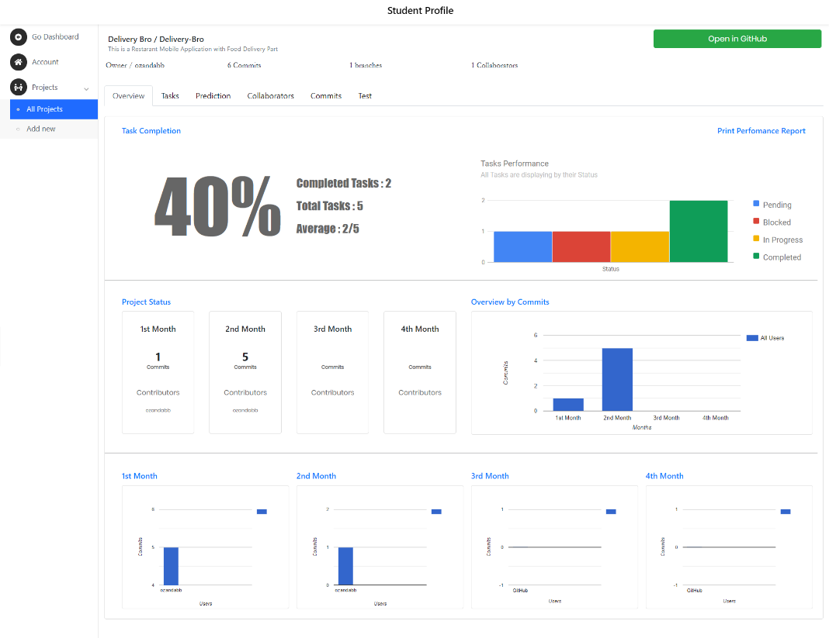
Project Overview

Slide 20
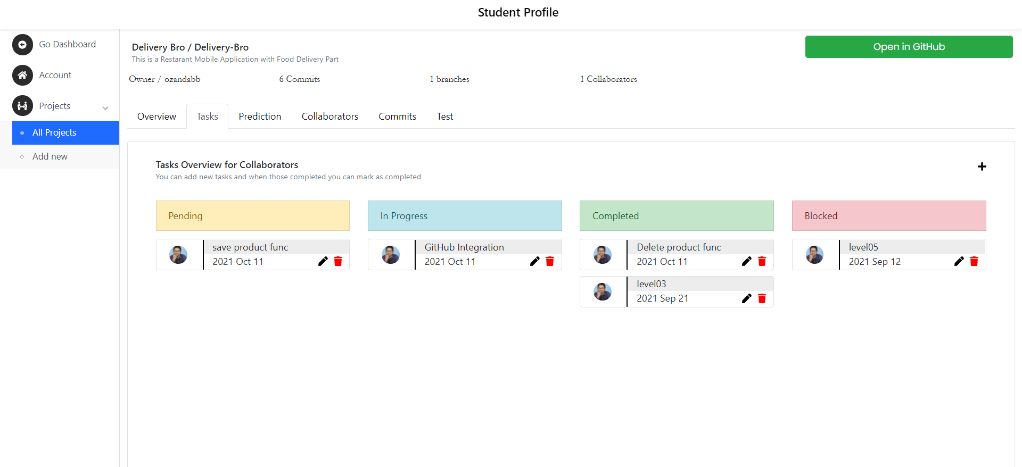
Task Management Dashboard

Slide 21
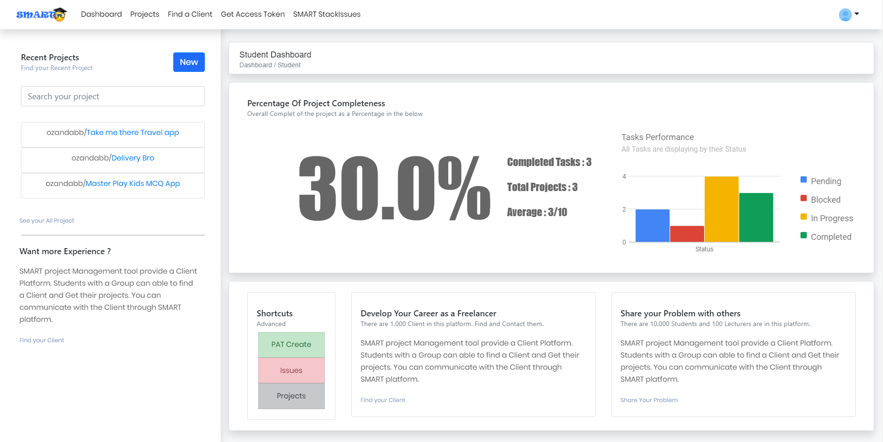
Student Dashboard

Slide 22
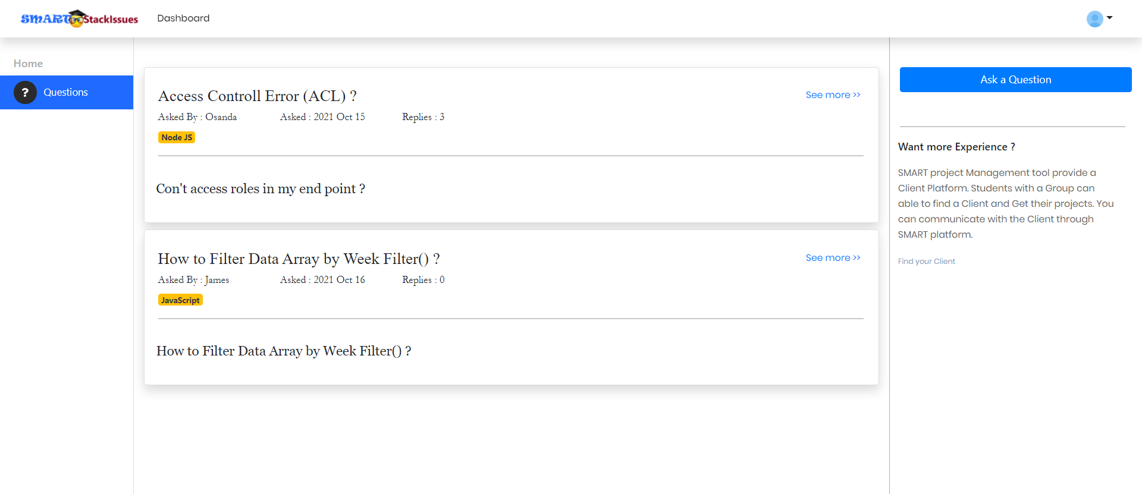
Issues Tracking

Slide 23
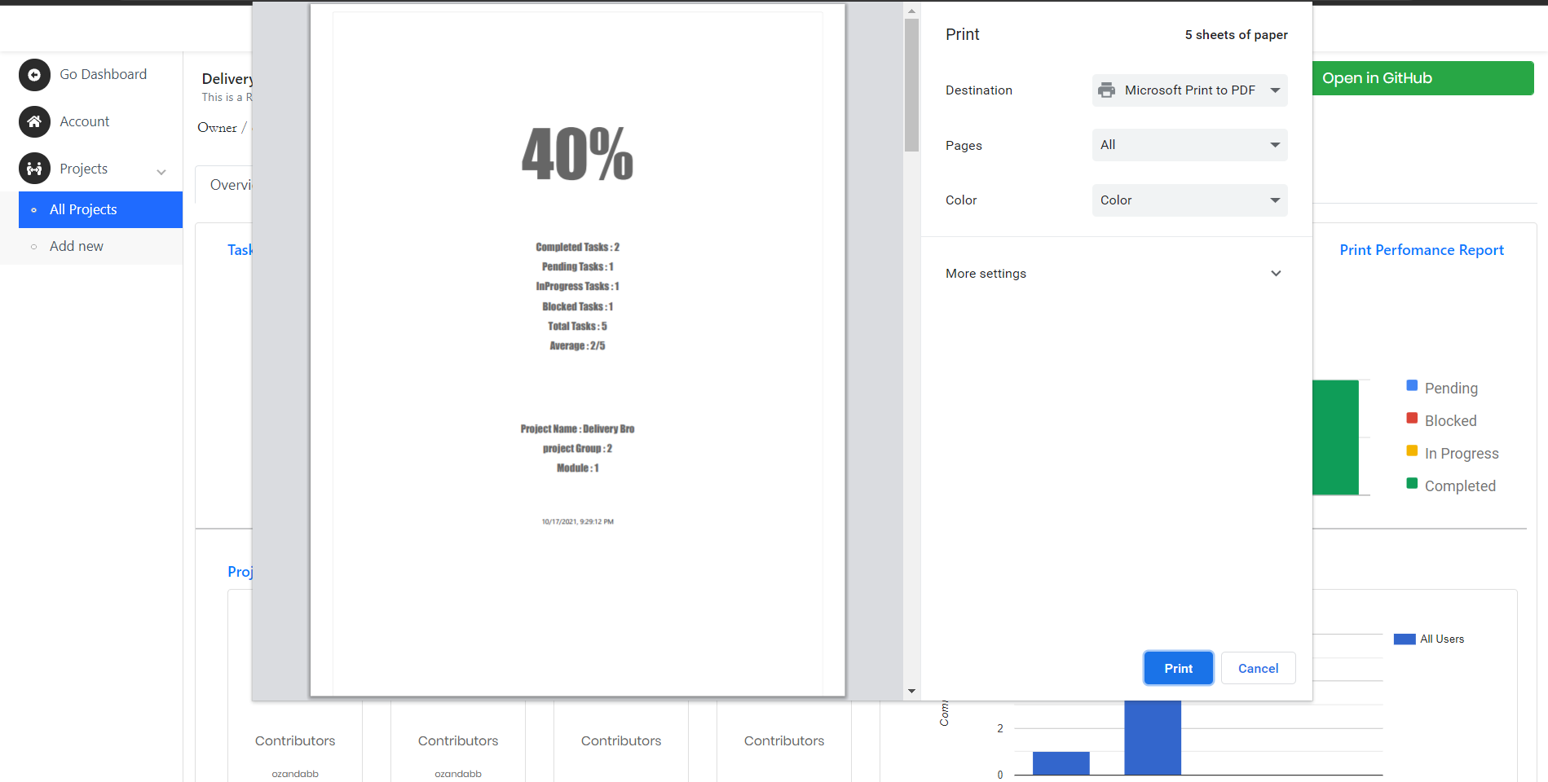
Performance Report

Slide 24

IT18129236 Isurindi H.G.P IT
Research Section 3
Track client meetings and document meeting content using voice to text conversion.

Slide 25
Objectives
The main objective is emotional and speech recognition into auto generated report and a satisfaction rate.
Sub Objectives
Creating client meeting platform
Client portal which provide facility to propose projects
Suggest Functions for students which inserted by students

Slide 26
Research Methodology
Methodology

Slide 27
Methodology
Created Client meeting platform
Client portal which provide facility to propose projects
Created voice to text converter to track the client meeting.
Create the recording functions of the meeting.
Student can download the final report and get the satisfaction rate
Student can download video recording for there future requements.

Slide 28
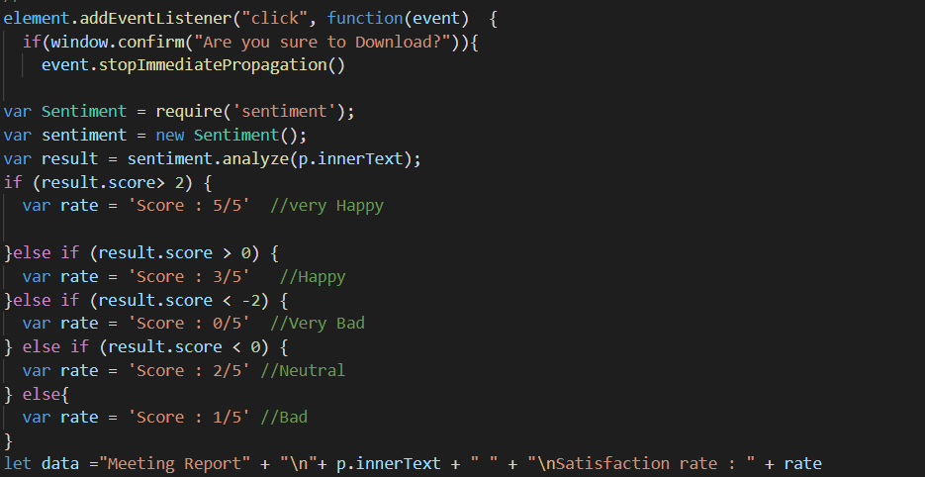
Satisfaction rate calculation
Calculate the client satisfaction rate as a text, score out of 5
Use the “sentiment.analyze” library to calculate the rate

Slide 29
Evidences
Evidences for the completion

Slide 30
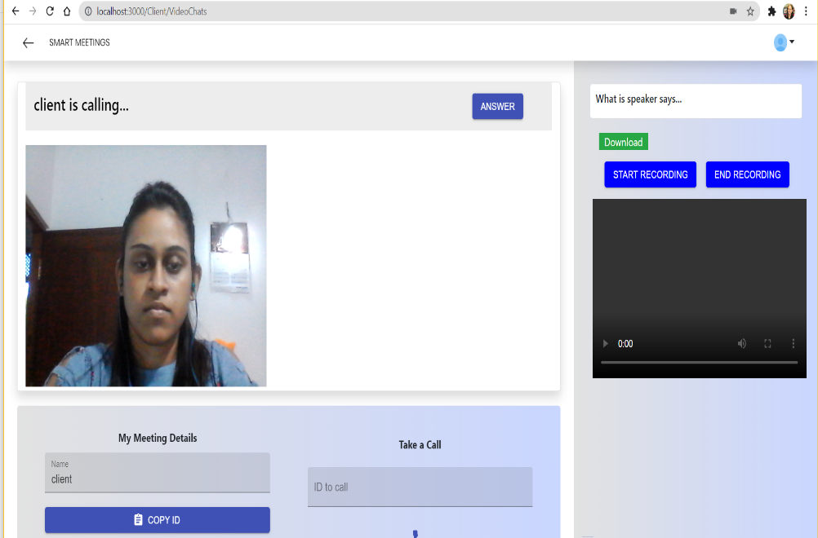
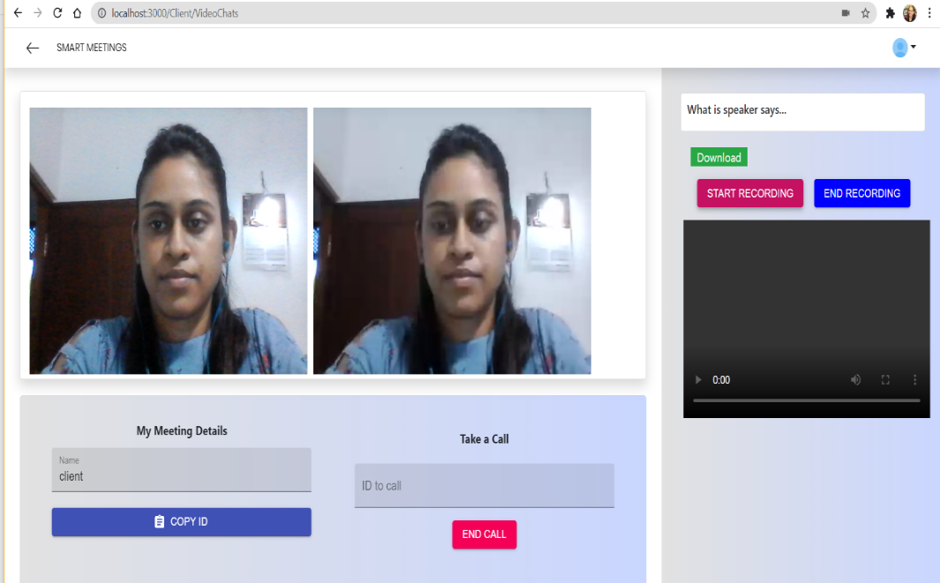
Client meeting platform and start the meeting

Slide 31
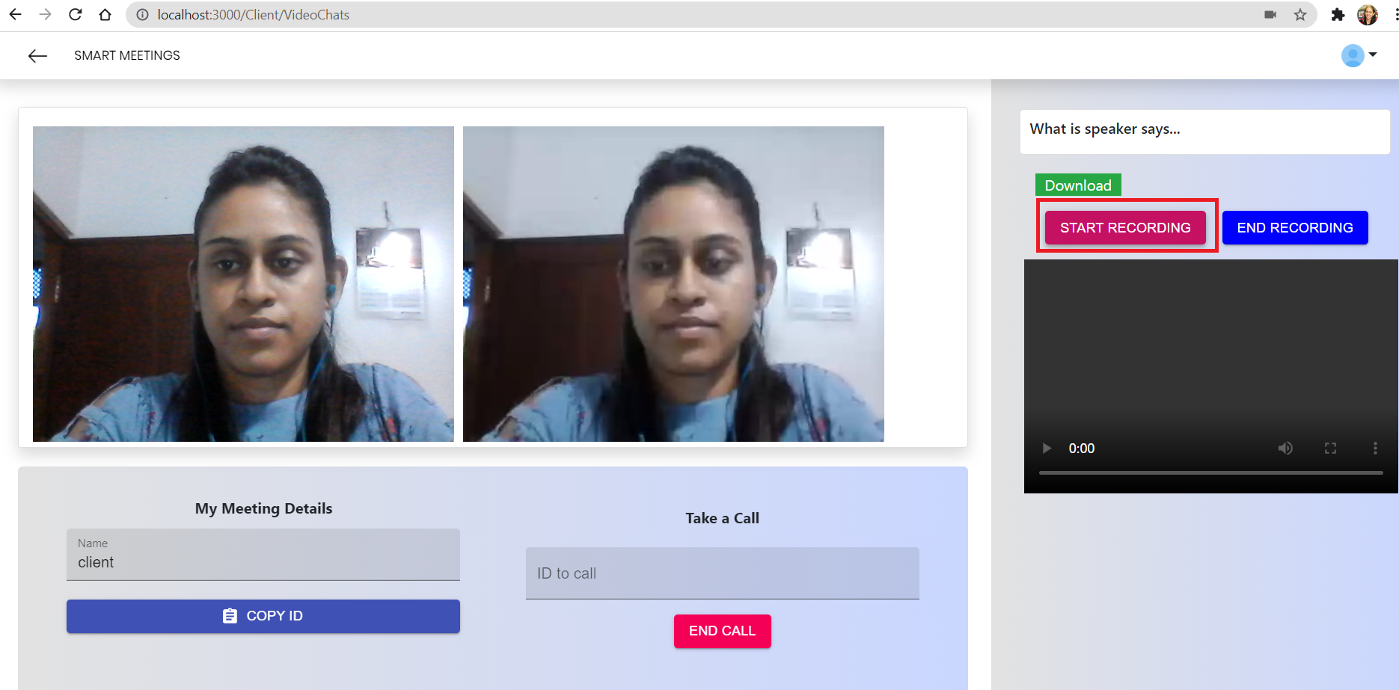
Start Recording …

Slide 32
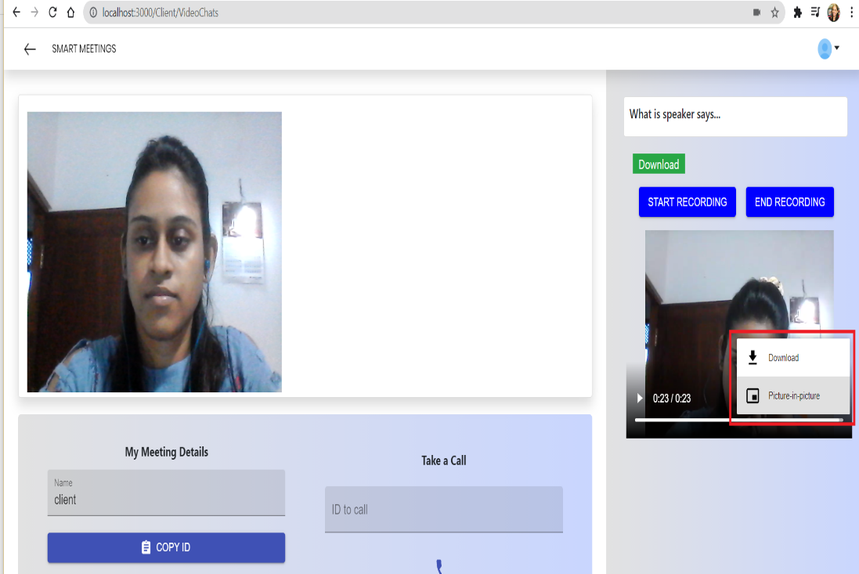
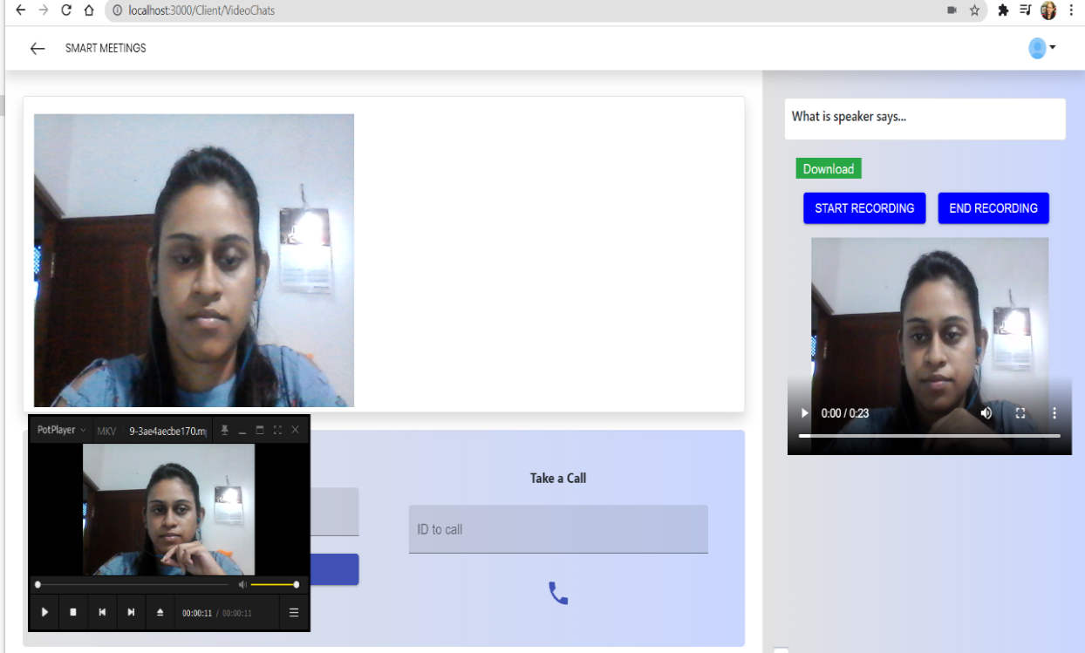
End Recording and Download the video

Slide 33
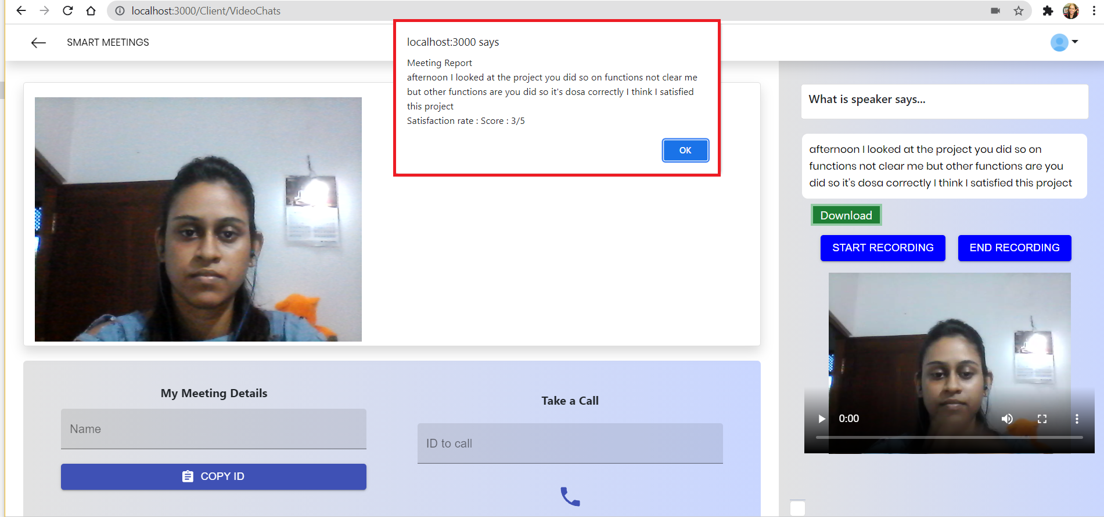
Calculate the client satisfaction rate

Slide 34
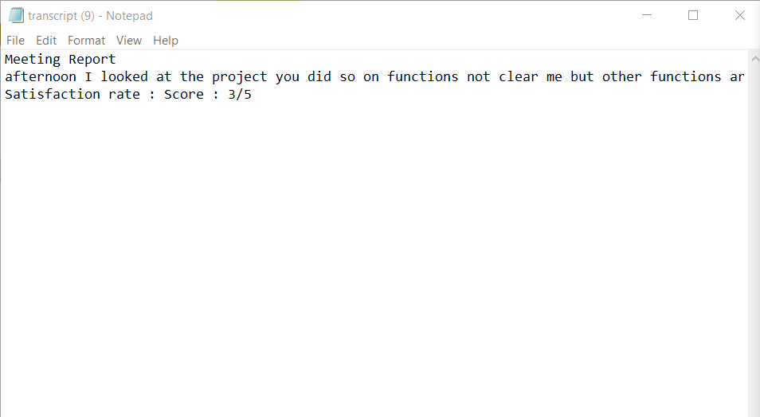
Meeting Transcript

Slide 35
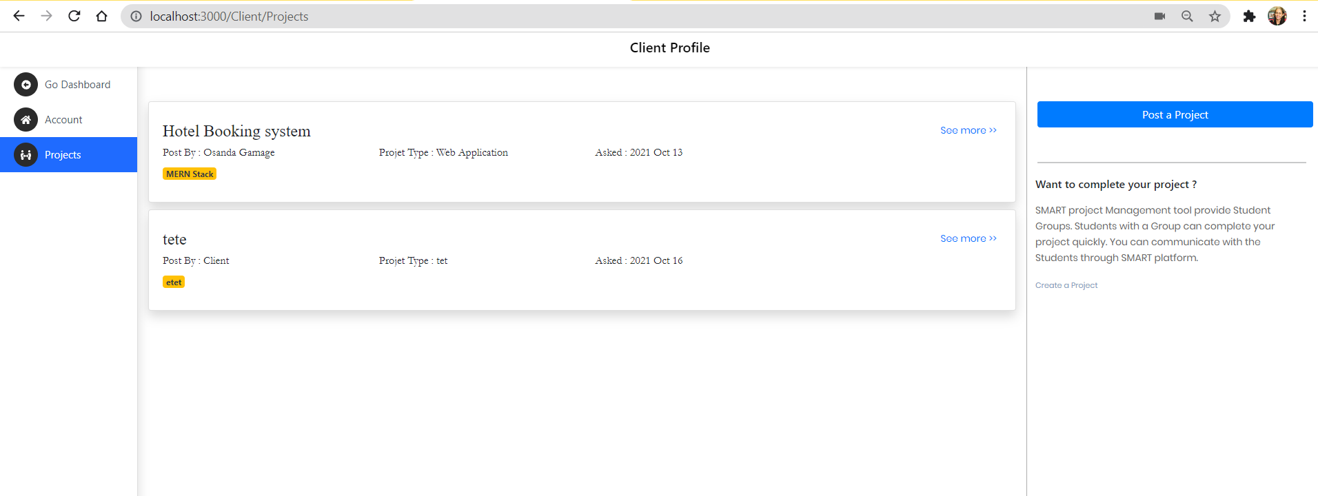
Propose projects

Slide 36

IT18003642 Navanjana E.H.D.T.D. IT
Research Section 4
Peer Review Assessment

Slide 37
Introduction
RESEARCH QUESTION
Research Methodology
Results and Discussion

Slide 38
Research Question
How to detect Free riders in the group project?
Are there any existing methods for this research component?
What should be considered when measuring the review polarity?
Is this proposed review component generating the expected outcome?

Slide 39
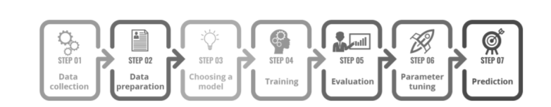
Research Methodology
PP1
PP2

Slide 40
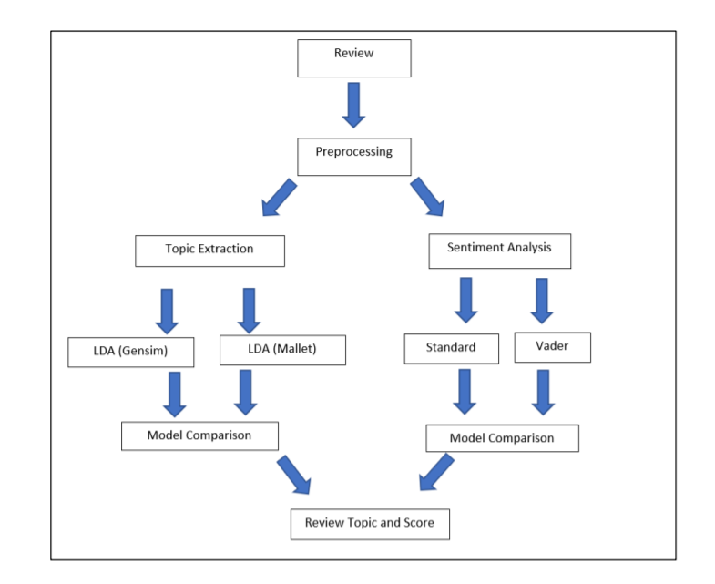
Sentiment Score
Coherence Flow

Slide 41
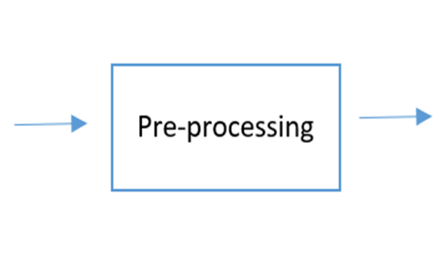
pp1 Priority based Preprocessing
Must Do:
Noise removal
Lowercasing
Should Do:
Simple normalization
Task Dependent:
Stop-word removal
Advanced normalization
Stemming / lemmatization
Text enrichment /augmentation

Slide 42
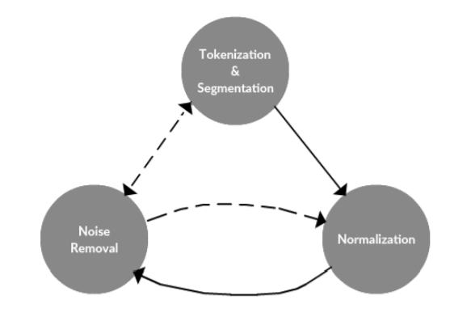
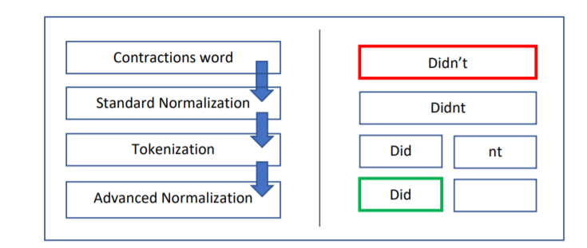
pp2 data preprocessing framework

Slide 43
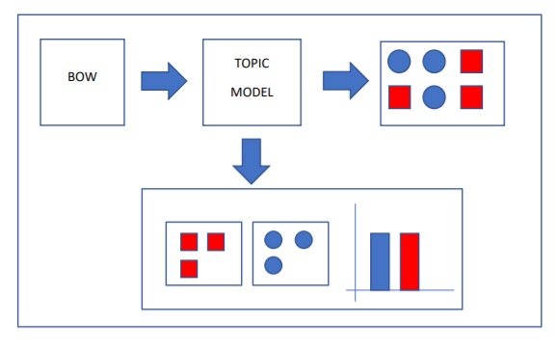
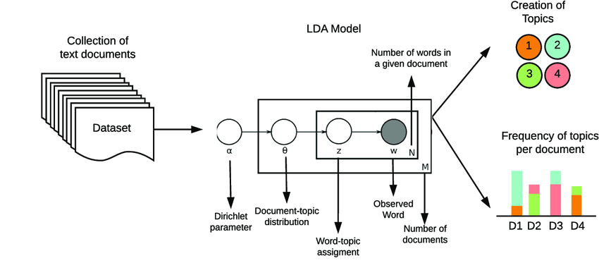
TOPIC MODEL

Slide 44
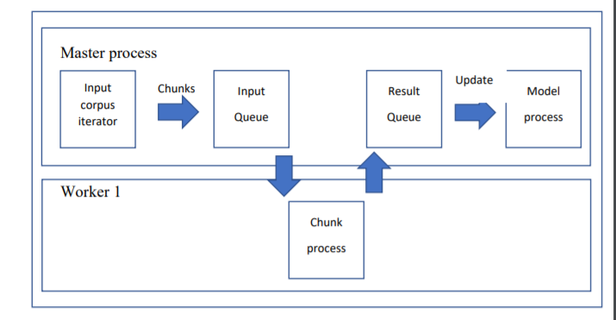
Model selection
General
Model
Multicore

Slide 45
Parameter tuning
Model parameters – Sentiment Analysis with VADER
Weight assignments
Model Hyperparameters – Topic model with gensim and mallet
Alpha
Beta
Coherence

Slide 46
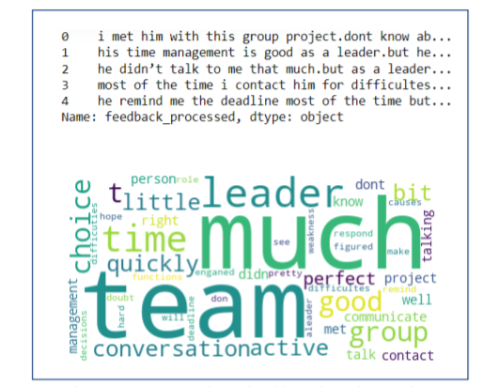
Results
Preprocessing validation with exploratory analysis

Slide 47
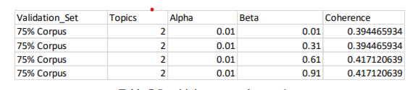
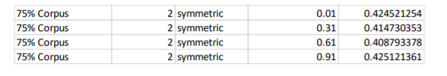
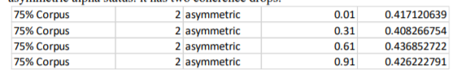
Results
Hyperparameter tuning

Slide 48
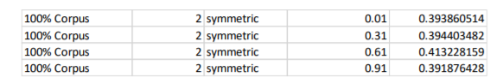
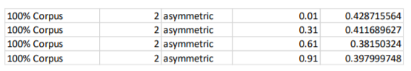
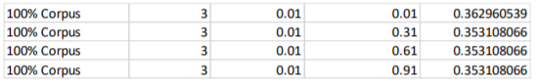
Results
Hyperparameter tuning

Slide 49
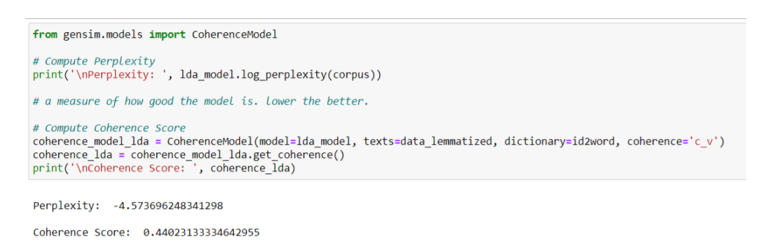
Results
Model evaluation

Slide 50
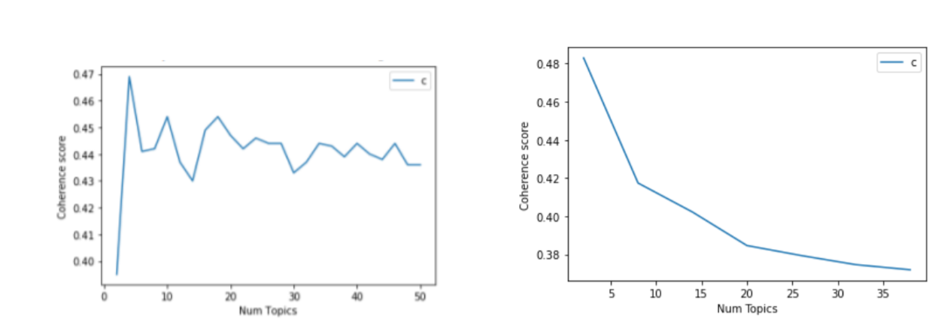
Results
coherence flow

Slide 51
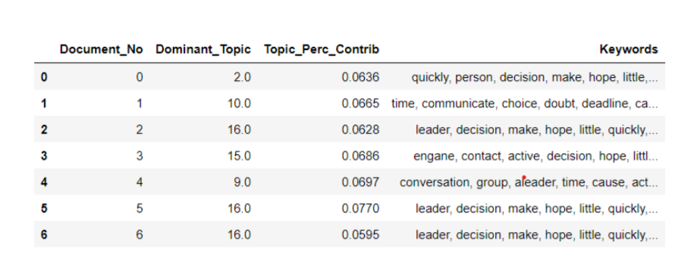
Results
Dominant topic coverage

Slide 52
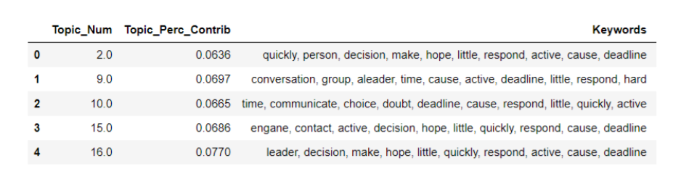
Results
topic contribution coverage

Slide 53
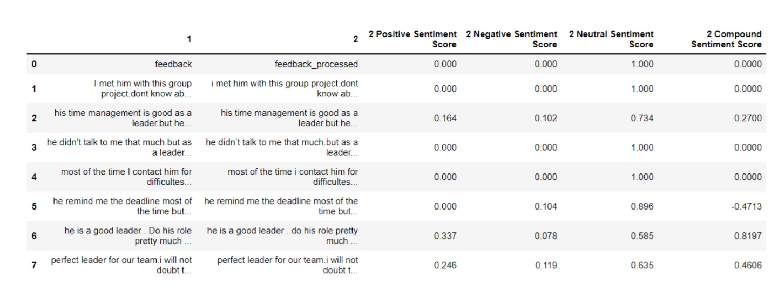
Results
Sentiment score

Slide 54
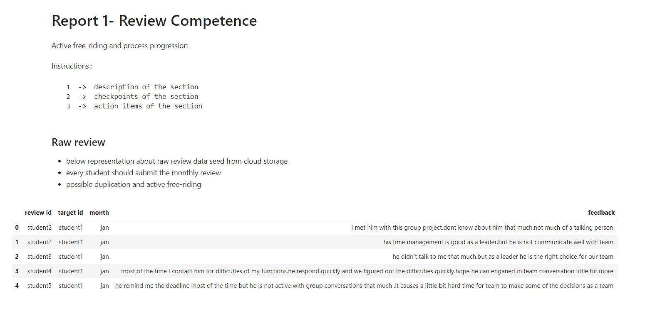
Reports

Slide 55
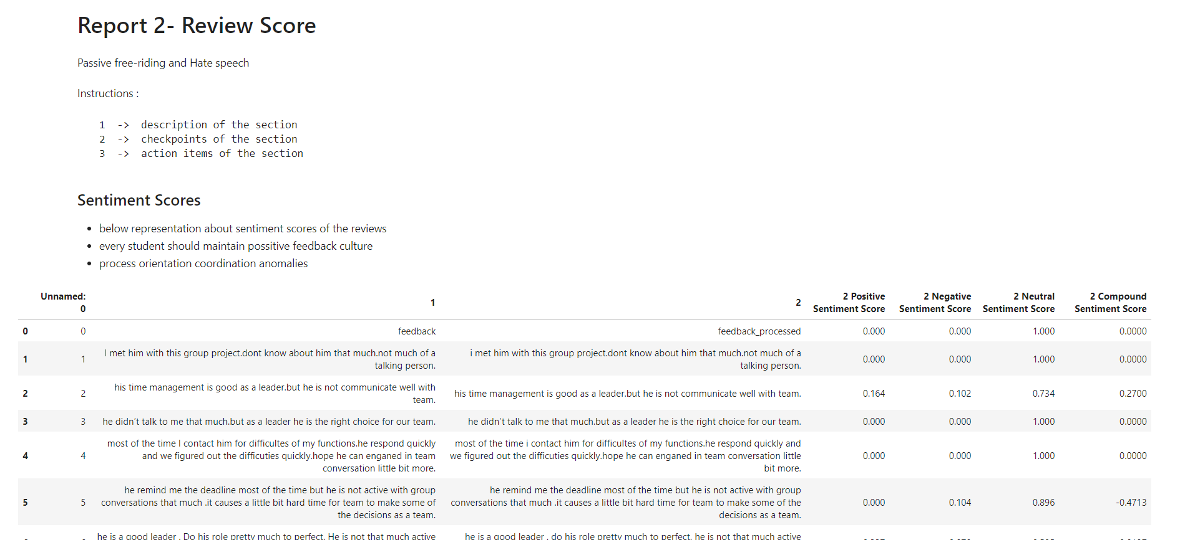
Reports

Slide 56
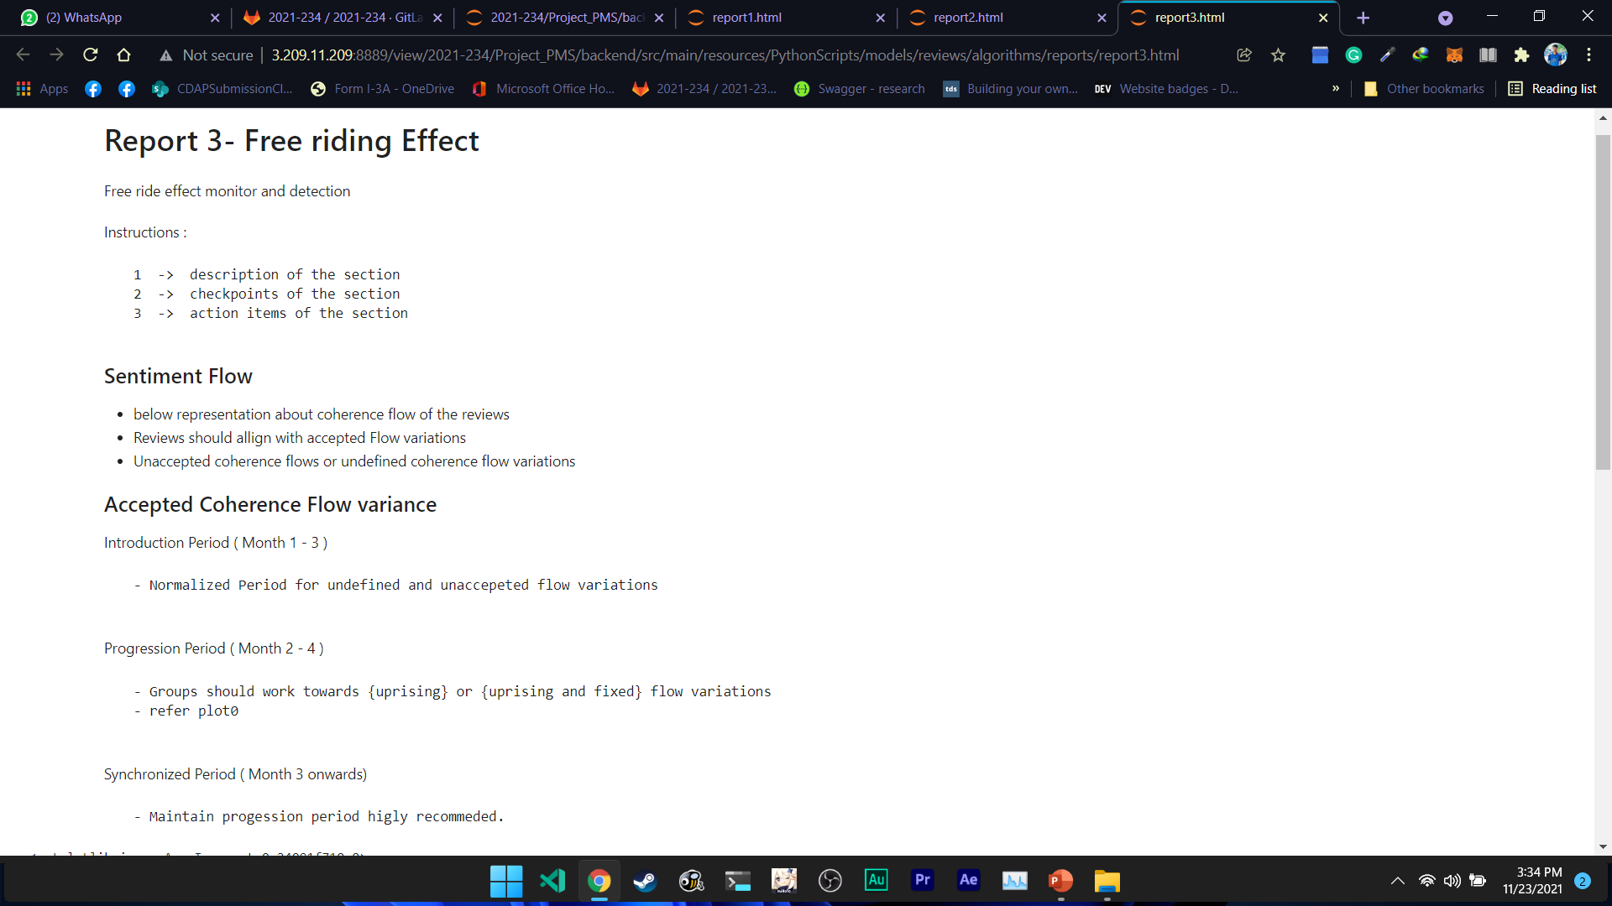
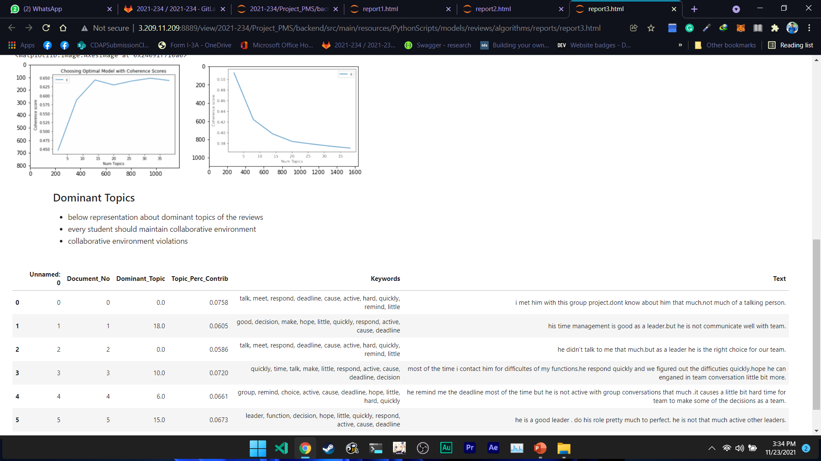
Reports

Slide 57
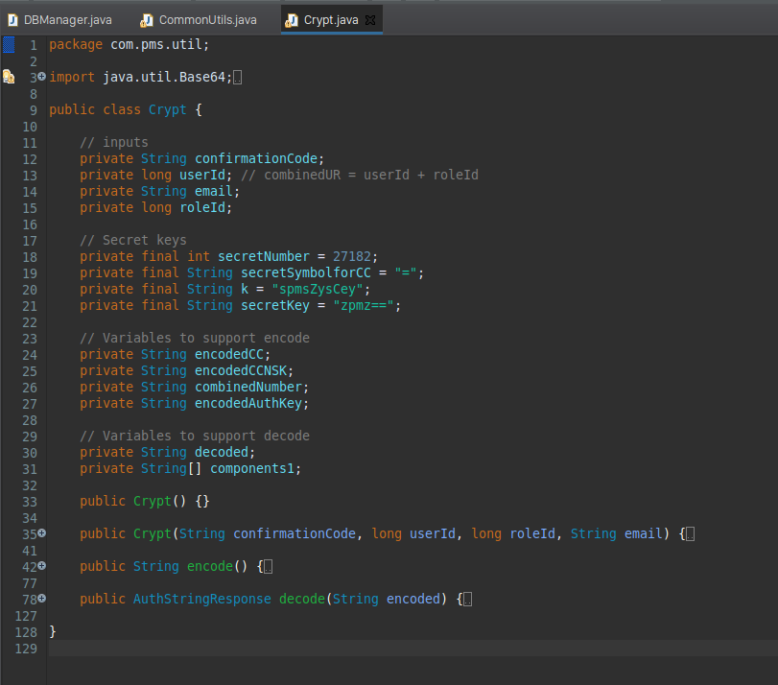
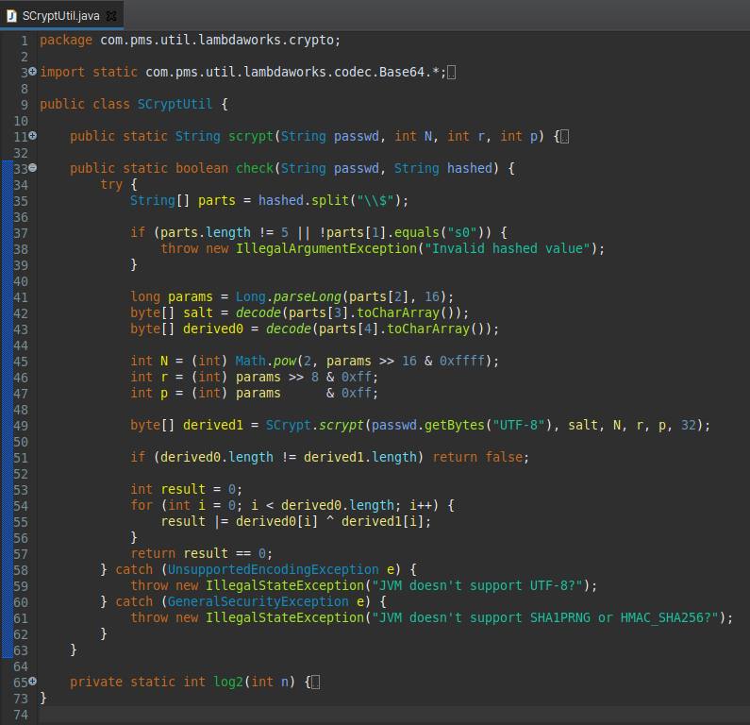
Risk Mitigation

Slide 58
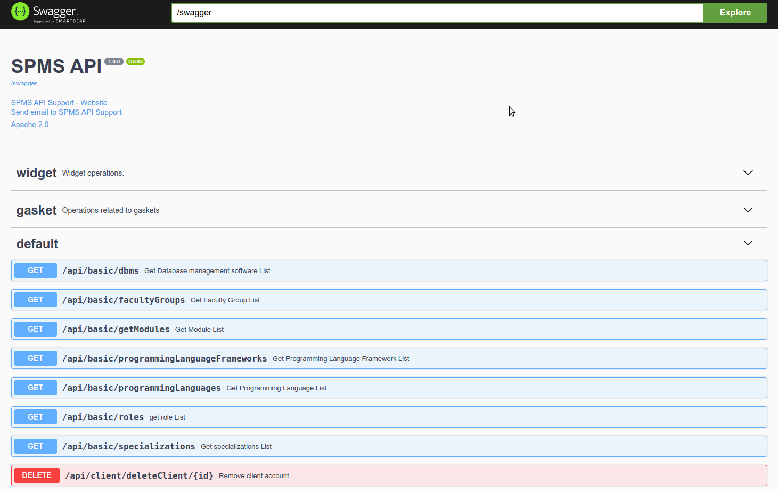
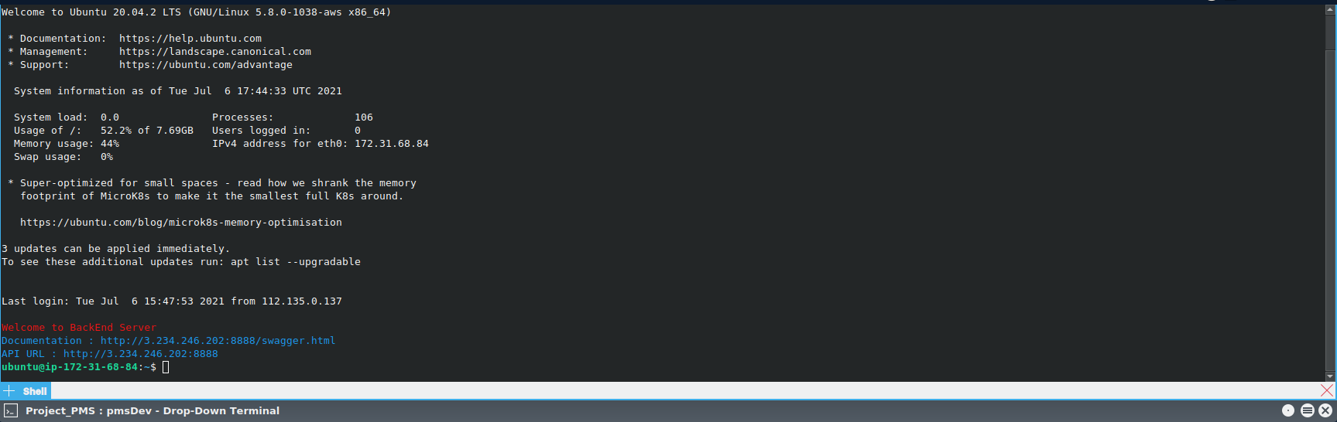
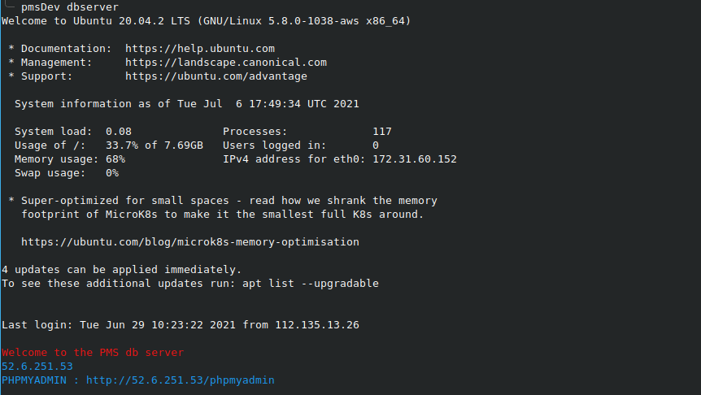
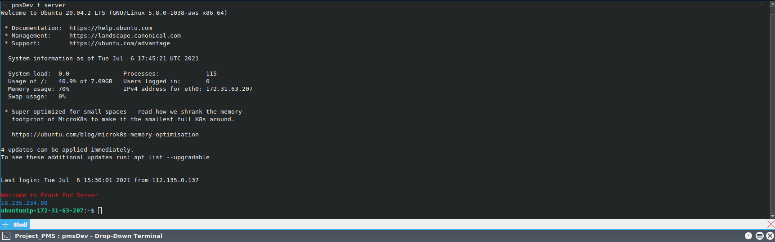
Standards and Best Practices

Slide 59


Commercialization
Users can download the free trial version with limited functionalities to a limited time period and if user satisfy with the product, They can purchase the system for the full price.
Since the target users are the universities, We can offer discounts for the product and they might considering to use the product.

Slide 60

Research Paper Publication Project Zone : An Advanced Undergraduate Project Management System for Software Development

Slide 61


